Slide 1
Wine Magazine Reviews 734-01 Data Mining Project
Khatoon Alghanim, Khulan Gankhuyag, Matthew Lipinski, Gauthamreddy Manemvenkat, Mariyam Rajeev, Chetan Vasudevan, Stacia Zembal

Slide 2
Agenda
Project Plan
Data selection and Pre-processing
Model 1: Text Mining & Decision Tree
Model 2: CART & Bagging Ensemble
Project Improvements

Slide 3
Project Plan
Problem Statement:
Can we create a model that is capable of predicting the variety of wine?
What other opportunities do we have to predict?
Goals:
Determine how to utilize the description attribute.
Does predicting null values increase model performance?
Dataset:
Challenging dataset with roughly 100K records and 10 attributes.
One attribute containing a description in text.
Each attribute having many factors.
Lowest 21 factors and highest with 30,284 factors.
Missing values.
Team Dynamic
Large team so we split into smaller groups.

Slide 4
Data Selection & Pre-Processing
Dataset for our project is obtained from: https://www.kaggle.com/zynicide/wine-reviews
Author: Zack Thoutt
Attributes | Description
Points | The number of points WineEnthusiast rated the wine on a scale of 80-100
Variety | The type of grapes used to make the wine (ie Pinot Noir)
Description | A few sentences from a sommelier describing the wine's taste, smell, look, feel, etc.
Country | The country that the wine is from
Region1 | The wine growing area in a province or state (ie Napa)
Region2 | Sometimes there are more specific regions specified within a wine growing area
Winery | The winery that made the wine
Designation | The vineyard within the winery where the grapes that made the wine are from
Price | The cost for a bottle of the wine
Province | The province or state that the wine is from

Slide 5
Python API For Collecting Wine data
A Restful API Was written which takes in a base URL and reads its page source and collects all the required parameters which we pass in the API code like, name of the country , description of the wine, price of the wine , region of the wine etc...
It brought the data into a new directory in the JSON format. The Python API read that file and converted each element of the data as a column and produced a CSV file .
SAMPLE CODE:
class Scraper():
"""Scraper for Winemag.com to collect wine reviews"""
def __init__(self, pages_to_scrape=(1,1), num_jobs=1, clear_old_data=True):
self.pages_to_scrape = pages_to_scrape
self.num_jobs = num_jobs
self.clear_old_data = clear_old_data
self.session = requests.Session()
self.start_time = time.time()
self.cross_process_review_count = 0

Slide 6
Model 1
Text Mining using R – Matt and Stacia

Slide 7
Text Mining: Overview
Algorithm: k-means, decision trees
Tool selection: R
First step included preprocessing wine's description.
Scrubbed text to lower case and removed numbers, punctuation, stopwords, and whitespace.
Found the frequent words and determined which words were commonly associated with red and white (cluster dendrogram).
Red: cherry, black, plum, berry, red, blackberry, tannins, blend, dark, and pepper.
White: ripe, fresh, oak, apple, white, peach, light, fruity, bright, vanilla.
Extracted the Red and White frequent words from the wine's description.
Developed Redness and Whiteness scores based on top frequent words.
Notes:
Frequent words outside of the red and white categories: fruit, aromas, finish, acidity, and rich.
Choice of algorithm:
Tool selection:
Data mining results

Slide 8
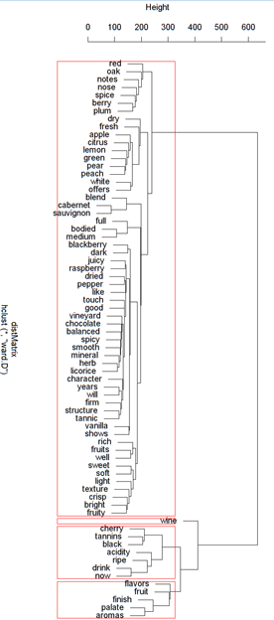
Cluster Dendrogram
"Hierarchical clustering is an alternative approach to k-means clustering for identifying groups in the dataset. Hierarchical clustering has an added advantage over K-means clustering in that it results in an attractive tree-based representation of the observations, called a dendrogram."
Used the following dendrogram as a supplement to the frequent words to determine words associated with red and white
http://uc-r.github.io/hc_clustering

Slide 9
Text Mining – Decision Tree
 | Predicted Red | Predicted White
Actual Red | 6,892 | 4,790
Actual White | 6,422 | 8,632
Model Results
Target: Variety at Red/White
Predictors: Price & Points
Determined White Category Most Important then a Price split on $26
Red & White Categories Utilizing 10 Frequent Words
Accuracy: 58%
Precision: 52%
Recall: 58%
F1: 55%
Notes:
Frequent words outside of the red and white categories: fruit, aromas, finish, acidity, and rich.
Choice of algorithm:
Tool selection:
Data mining results

Slide 10
Model 2
CART & Bagging Using Python: Chetan and Mariyam

Slide 11
Overview
Tool Used : Python
Predictors : Price,Region,Variety,Winery
Target : Points
Models Used: CART,Bagging on CART

Slide 12
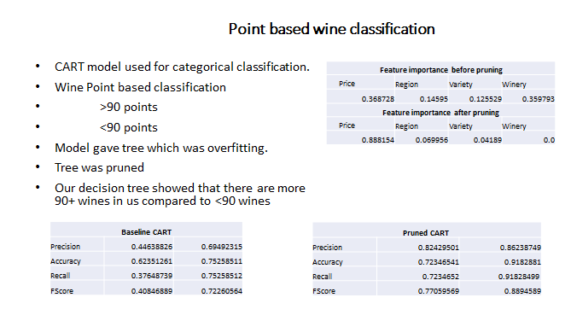
CART:

Slide 13
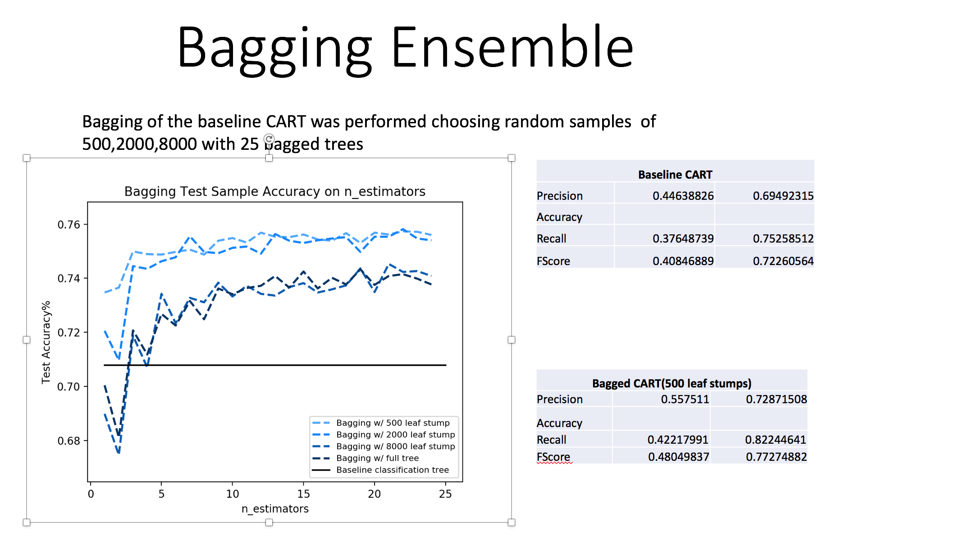
Bagging:

Slide 14
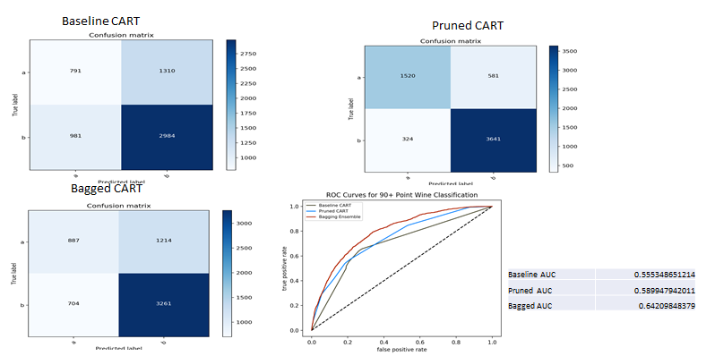
Confusion Matrix & ROC

Slide 15
Project Improvements
Models
How did others on Kaggle use this dataset
What did we learn and how can we improve
General
Web Scraper: Attempt to get more data
Text Analysis: Utilize Python vs. R in the future
Balancing the data.
Additional Attributes: Recently the author added the Taster Name and Taster Twitter handle.
This would have been a good opportunity to tap into twitter data.

